Slide 1
European Payment Institutions Federation: General Presentation
Secretariat General - info@paymentinstitutions.eu

Slide 2
About EPIF
Founded in 2011, the European Payment Institutions Federation (EPIF) represents a broad range of payment institutions participating in Europe’s payment sector.
Membership is open to licensed payment providers in the European Union, those seeking authorization and their national associations.
Our growing membership covers a diverse range of business models:
Three-party Card Network Schemes E-Money Providers E-Payment Gateways Money Transfer Operators Acquirers Digital Wallets | FX Payment Providers and Operators Payment Processing Services Independent Card Issuers Payment Initiators Account Information Service Providers Collecting PSPs

Slide 3
Our Members
Board Members
Corporate members
Observers
Association members

Slide 4
Our Mission Statement
Be the voice of a competitive and innovative payment sector in Europe
And help advance the overall regulatory and political objectives of the payment sector, by:
Ensuring that payment institutions are fairly and appropriately represented in the EU, including in standard setting bodies.
Communicating the role and complexities of the payments industry in a clear fashion to policymakers.
Acting as a neutral conduit to ensure Members are informed of EU deliberations and decision-making.
Providing an impartial mechanism for Members to comment on proposals and to provide input to the EU.

Slide 5
Our Policy Objectives
Promoting competition, innovation and quality in payment services, that achieves the best outcomes for businesses and consumers alike.
Ensuring the highest level of harmonization across Member States to maintain a level playing field for both payment providers and consumers.
Fostering EU regulation that is future proof, risk-based and proportional, taking into account the diversity of sizes and business models in the payment sector.
Developing and shaping high quality standards and ensuring international consistency.

Slide 6
Our Policy Priorities
A holistic and inclusive approach to payment security that takes into account risk management practices in the digital space and all players in the payment chain, from merchants to consumers.
Maximum harmonization for the anti-money laundering (AML) framework, which should take into account non face-to-face and non-bank based payment providers.
Efficient online and cross-border identification, authentication and authorization processes, that work across the EU to facilitate the safe onboarding of customers remotely.
A proportional tax and VAT regime, that takes into account the complexity of the payment chain, the variety of business models that it includes and the importance of the sector for the wider economy.
Access to payment systems by non-bank payment providers is fundamental at an EU level to create more payment options for consumers and businesses.
A balanced approach to data protection and the use of data, which should take into account the benefits of AI such as combatting fraud and AML, as well as the existing legal framework for payment providers.

Slide 7
Effective Resourcing and Capability
Clear governance structure & legal status
Broad & representative membership
Clear identity, recognition by peer Associations & visibility
Offices in Brussels
Dedicated staff, and elected Chair
Active working committees for its members
Membership and active participation in all relevant standard setting bodies
An EU Public Affairs strategy: intelligence, analysis, strategy execution, and contact programs
EPIF is based on:

Slide 8
EPIF membership structure
All members are entitled to the following services:
Representation on the Executive Board and General Assembly
Representation on EPIF Committees
Contribution to position papers and official documents
Receive EPC and ERPB documentation
Receive ad hoc and daily regulatory updates

Slide 9
Governance Structure
Governance
General Assembly
General Assembly
Executive Board
Technical Committee meeting
Task Forces
External Representatives (ERPB & EPC)
Outsourced Secretariat and Support
Executive Board
Working groups
Technical Committee
Task Forces
Afore Support
Secretariat

Slide 10
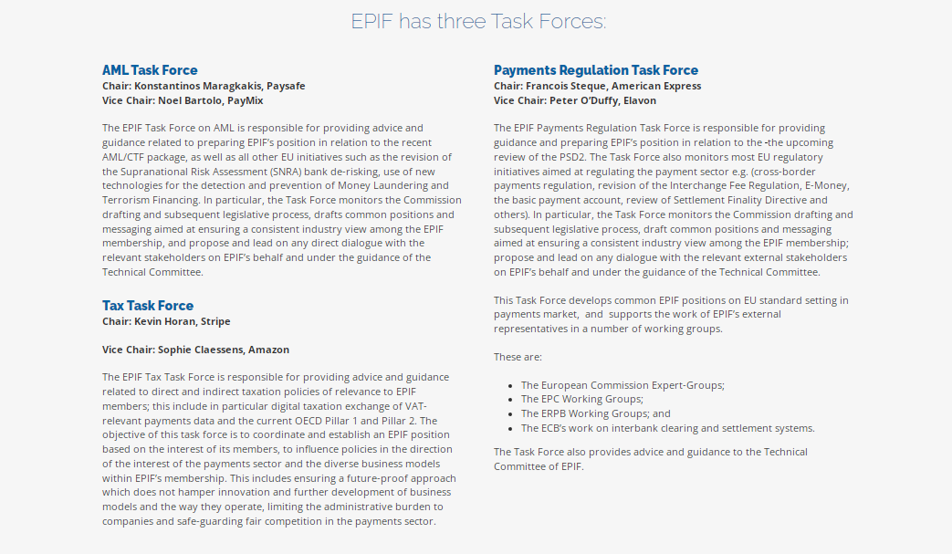
EPIF has three dedicated Task Forces

Slide 11
Why become a member?
An interactive website to access relevant documents and intelligence.
Access and active contribution to the European Payments Council and the Euro Retail Payments Board.
Regulatory interactions with the European Commission, European Parliament, Council of the EU, European Central Bank and Supervisory Authorities.
Access to core decision making fora and interlocutors.
Effective standard setting and Public Affairs capability.
Working Committees on specific implementation and business issues.
Daily regulatory update on key issues.

Slide 12
Marketing benefits
Corporate visibility on the EPIF website:
Corporate logo and company information (description, link to corporate website and business model) easily accessible.
Corporate studies, reports, videos and events uploaded to the relevant section.
External representation benefits:
Speaking opportunities to European and International Payment forums and conferences.
Opportunities of representation via EPIF to expert groups formed by the regulatory bodies.
Outreach meetings visibility:
EPIF Presentations and brochures shared with policy makers (corporate logos included).
Coalition of specific business models (e.g. acquirers, remitters) forming a common position to be sent to policy makers, co-signed by the EPIF membership.
Rapporteurship benefits
Leadership to a position paper on a regulatory issue of importance to a specific business model.
Active contribution to the formation of the position papers.

Slide 13
For more information
EPIF Secretariat c/o Afore Consulting
Rue du Trône 100,
1050 Brussels Belgium
Nickolas.Reinhardt@aforeconsulting.eu
Tel: 0032 475 330039
Andreia.jones.Rodrigues@aforeconsulting.eu
Tel: 0032 472 241589

Slide 14
promoting
innovation, competition and quality
of payment services

